Slide 1
Alternatives Using the Leap Motion to Extend Mid-air Word-gesture Keyboards
Garrett Benoit
Master of Computer Science Defense

Slide 2
Introduction

Slide 3
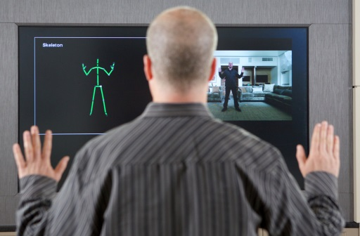
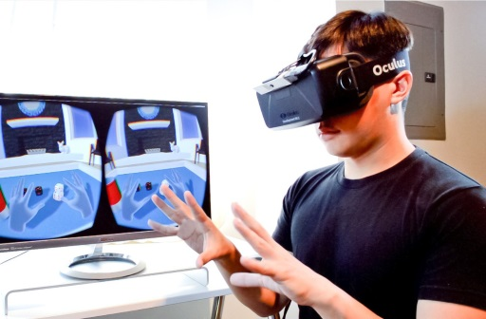
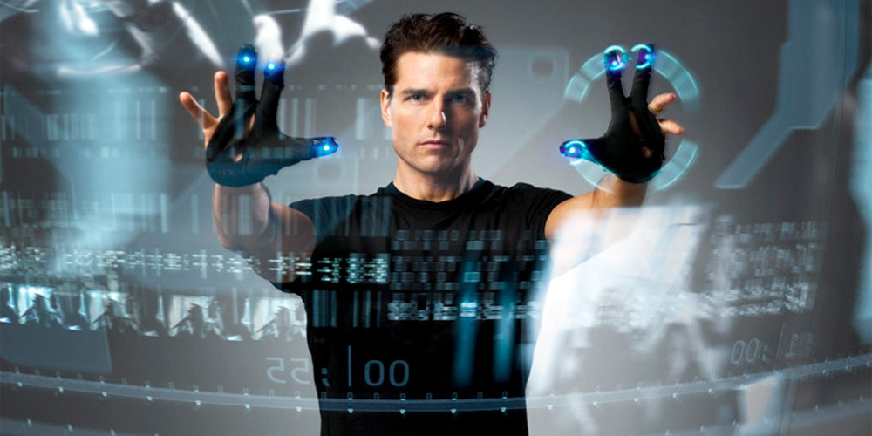
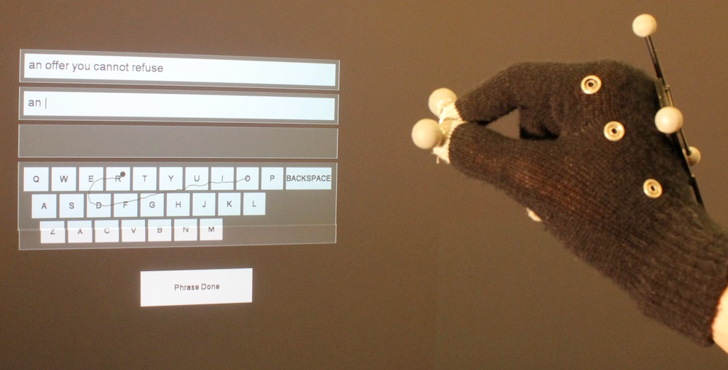
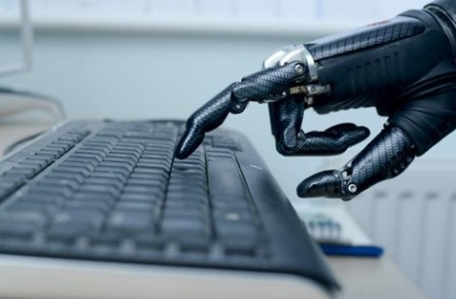
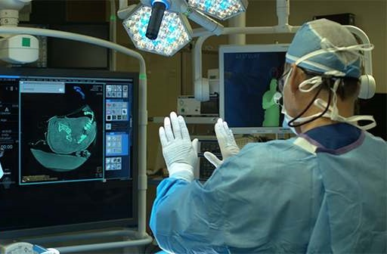

Introduction
Why Mid-air Keyboards?
Typical Usage
Need for Change
Challenges[1][2][3]
Purpose
The emergence of user experiences based solely on mid-air, gesture-based interactions garner the need for efficient mid-air, gesture-based text-entry.
Problems[1][2][3][4][5]
Focused on large displays
Requires standing
Requires orthogonal positioning
Inconvenient tracking devices/wearables
Non-personal
Tracking
Character Selection
Word Separation
Size of Keyboard
Motor Space vs. Display Space
Fatigue
Gorilla Arm Syndrome[9]
Use the Leap Motion Controller to explore alternative methods of word separation for mid-air word-gesture keyboards more suited to modern gesture environments
Gaming[4]
AR & VR[6]
Accessibility[7][8]
Medical[1]

Slide 4
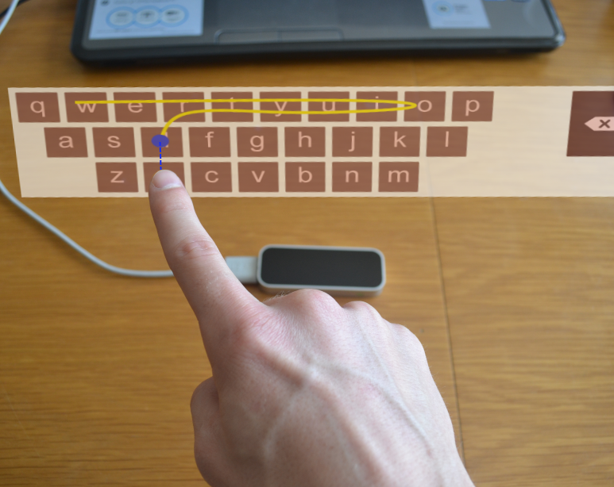
Overview
Mid-air Interactions
Keyboard Design
Experiment Design
Results & Discussion
Conclusion
Acknowledgements
Questions

Slide 5
Mid-air Interactions

Slide 6
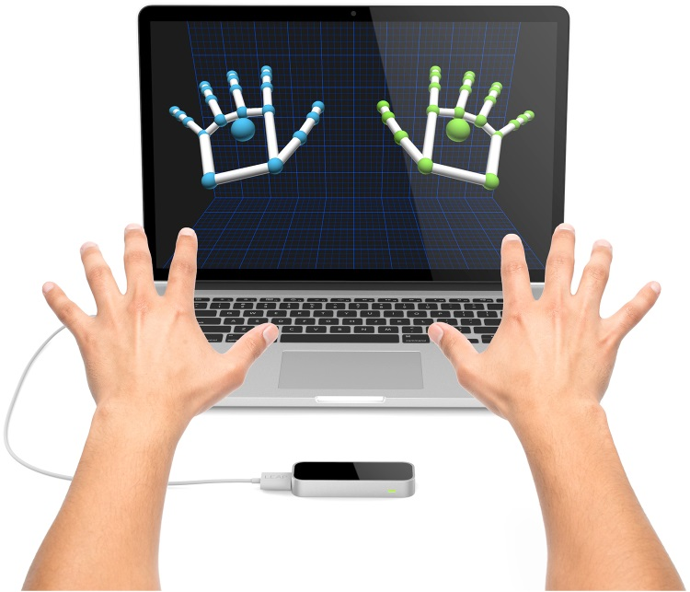
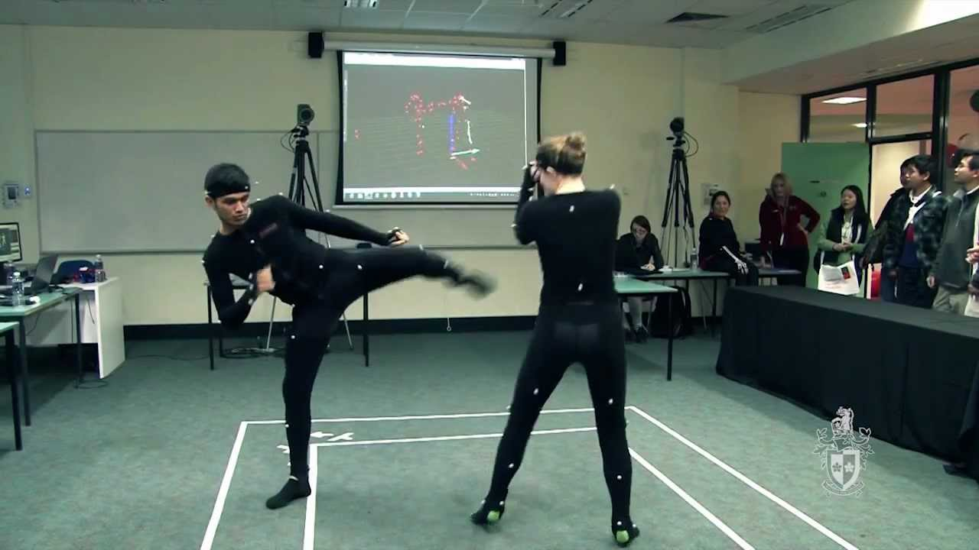
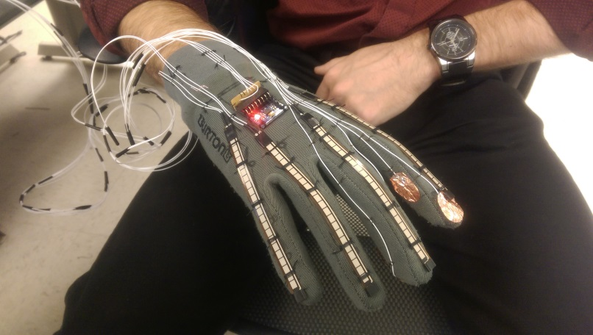
Tracking
Typical Interaction[1][2][4][5]
Limitations
Barehanded Interaction
Leap Motion[13][14][15]
Trade-offs
Loss of Tracking
Environmental factors
Lighting
Obstruction
Failed Recognition
PC specs
Range
Microsoft Handpose[16]
“Come As You Are”[10]
Users should not be encumbered by wearing wires or external devices for interactions[11]
Better for gestural interactions than traditional devices[12]
Inconvenient
Expensive setup
Encumbered mobility
Non-portable
Fails to address accessibility[7][8]
Robust Tracking
Precision on the sub-millimeter level
Auto stabilization
Gesture tracking
Tool tracking

Slide 7
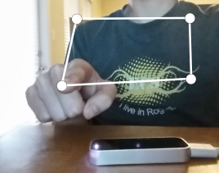
Mid-air Pointing
Typical Usage[17][18][19][20][21]
Mid-air Keyboards[1][2][3]
Limitations
Solutions?
Orthogonal Projection[3]
Calibrate Personal Interaction Space[22][23]
Distance Dependence[2]
Affected by movement as simple as hand jitter
The Leap Motion Controller minimizes this by stabilizing for micro-movements
Ray Casting onto Large Screen Displays
Selection and manipulation of on-screen objects
Selection of single characters
Drawing word-gesture paths
Strength:
Minimizes distance dependence
Lessens the effects of decoupling
Weakness:
Limited Reach
Orthogonal restriction
Strength:
Custom interaction space
Nullifies distance dependence
No spatial restrictions
Weakness:
Increases the effects of decoupling[1][24]

Slide 8
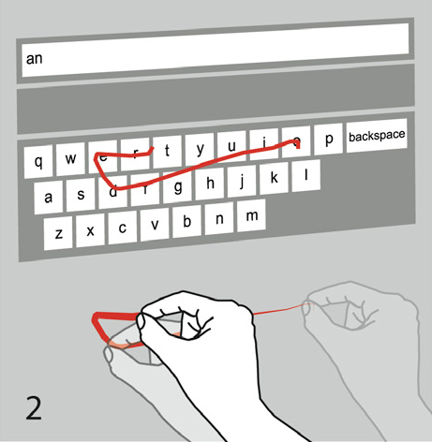
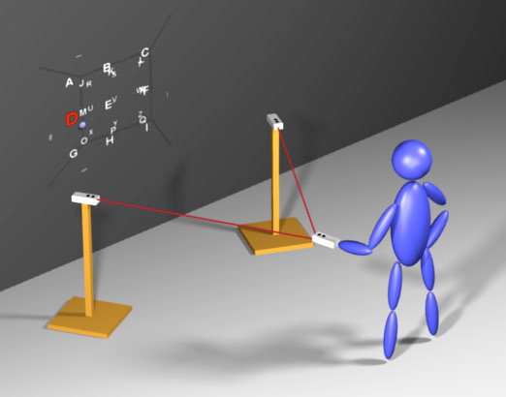
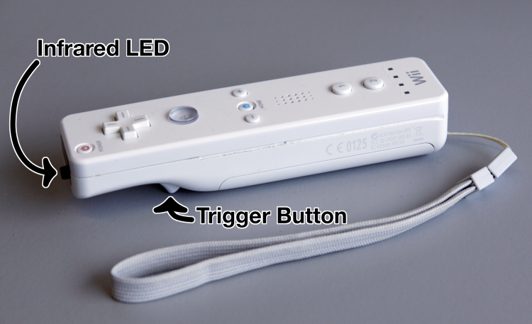
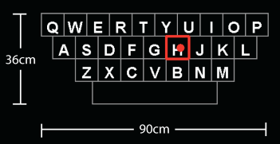
Mid-air Text-entry
Selection-based
Limitations[1,2,3]
Gesture-based
Vulture[1]
Word-Gesture Keyboards[29][30][31][32][33]
Many Techniques
Alternative Layouts[2][3][25][26]
Hovering[27]
Multi-tap[3]
Accelerometers[26]
Selection-wheel[2]
Bimodal Approach[2]
Distant QWERTY[2]
Modified Wii-mote
Bimodal Entry
Qwerty Layout
18.9 WPM
No visual feedback on errors
Single input text-entry is inherently slow
Doesn’t have much room to improve
AirStroke[4]
11.0 WPM
Showed possibility of continuous gesture recognition on interaction plane[4][22][23]
Handwriting?[28]
Limited to ≈15.0 WPM
Alternatives?[1]
First mid-air WGK
Pinching
Results
11.8 WPM Single Session
20.6 WPM Repeated Sessions
28.1 WPM Training on Single Phrases
59% speed of touch
Analyze gestured shape against word-shapes
Typical Touch Rates
Up to 25 WPM after 35 minutes of practice
Up to 46-50 WPM for single phrases

Slide 9
Keyboard Design

Slide 10
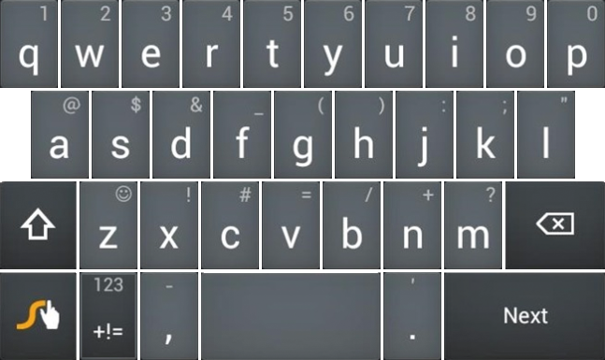
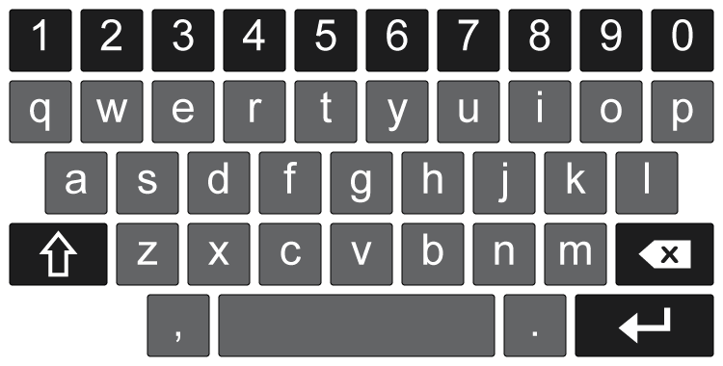
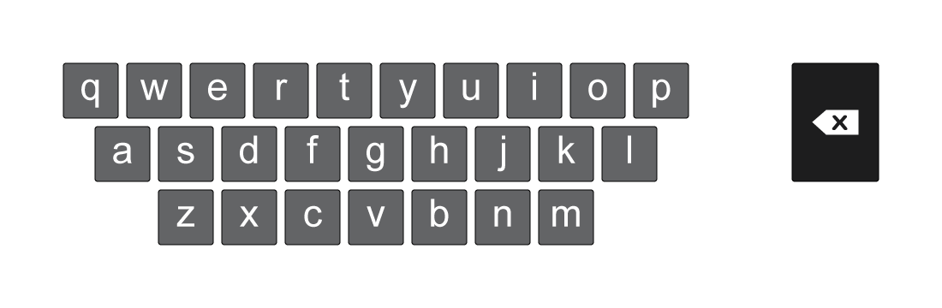
Keyboard Layout
1st Generation
2nd Generation
Final Layout
952x212 px
64x64 px keys
10 px gaps

Slide 11
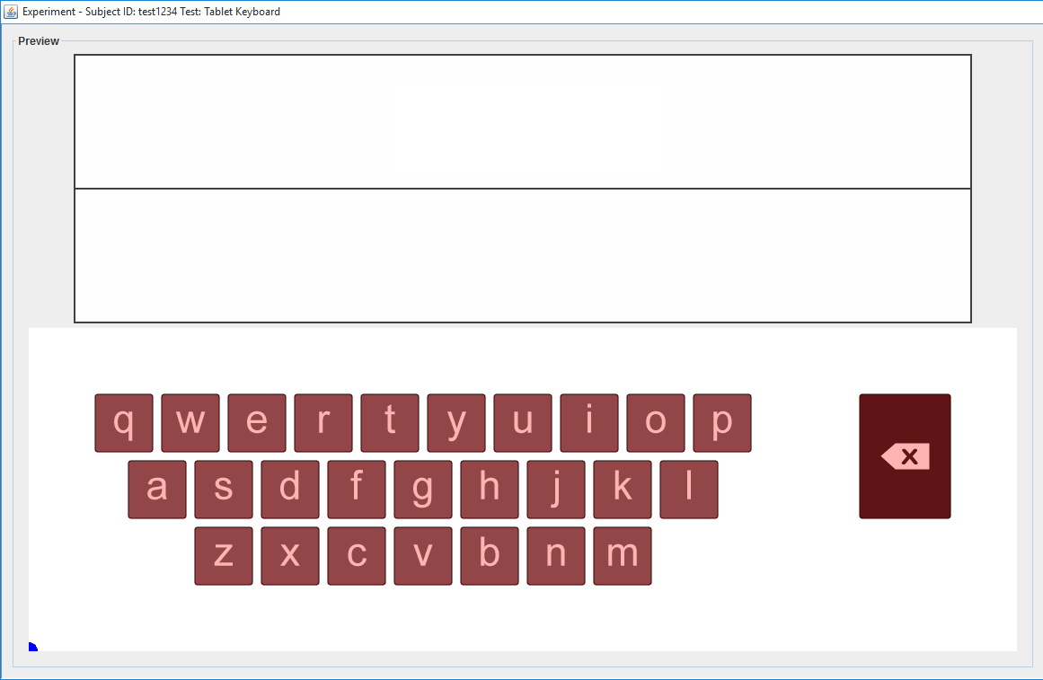
User Interface
Word Display Area
Transcription Area
Virtual Keyboard
Finger or Stylus
Position on Keyboard
Gesture Path
te
st
dt
te
st

Slide 12
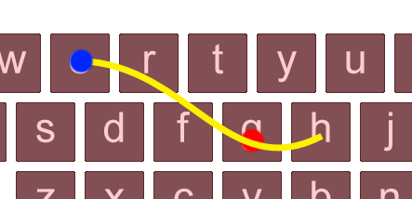
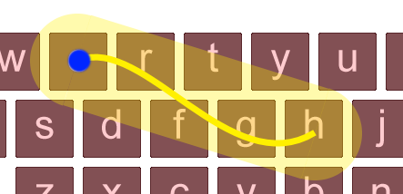
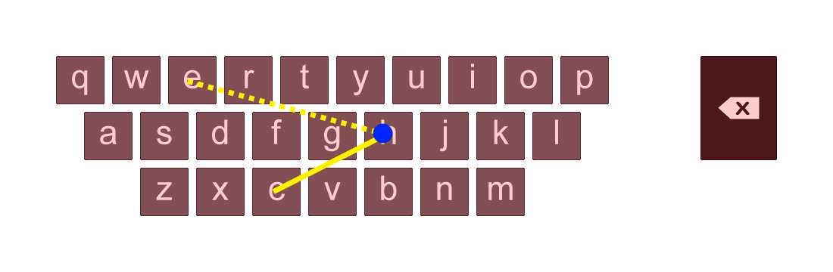
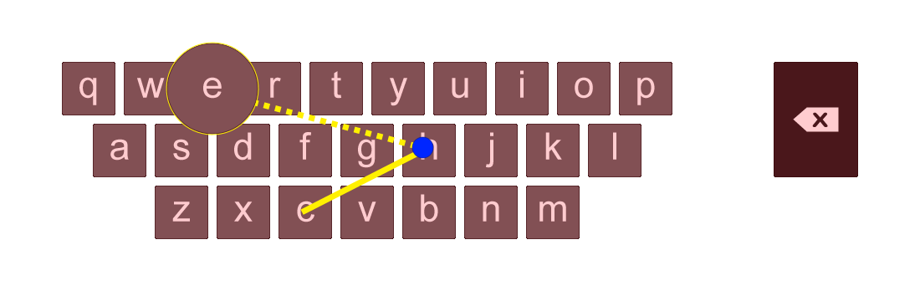
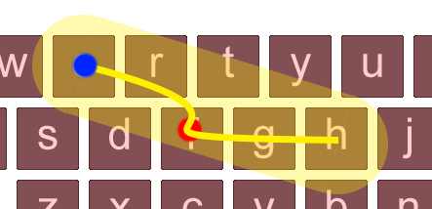
WGK Implementation
Traditional Word-gesture Keyboard[29][30][31][32][33]
Pseudo Word-gesture Keyboard
Press Detection
Key Enlargement
Path Protection
Limitations
Sensitive to detecting errors after first error
Requires error correction
Erroneous character production mid-gesture
Interrupts gesturing
Circular detection for expected letters
diameter 140% larger than key size
Example
Uses recognition algorithms to analyze gestured word-shapes
Already known to work well for touch and mid-air[1]
Outside of the scope of this study
Doesn’t analyze word-shapes
Takes advantage of known displayed words
Detects presses as word is being gestured
Similar look and feel to Traditional WGK
On Touch Activation
On Touch Deactivation
When passing over of expected characters
Deviations in generated path
Default angle 165º
Expected path is between previous and next expected letters
Path width is 62.5% larger than key size
Angle detection decreased to 90˚
Example
No Path Protection
Path Protection
Error with Path Protection

Slide 13
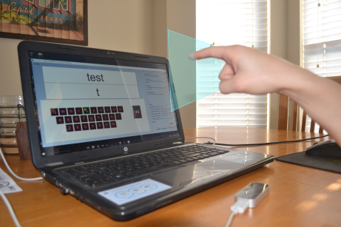
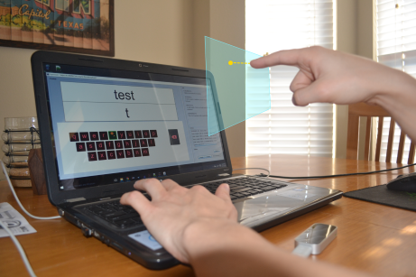
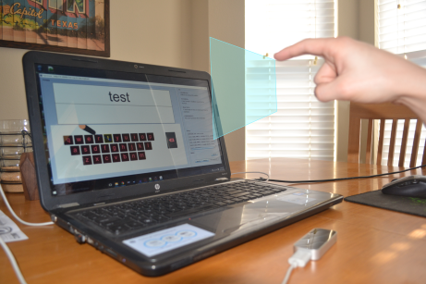
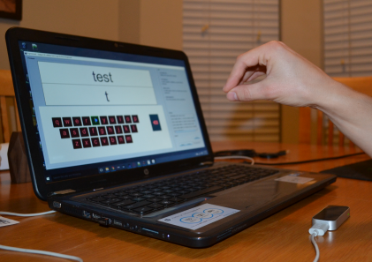
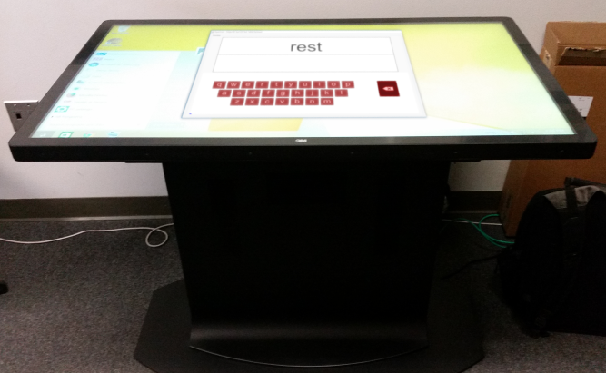
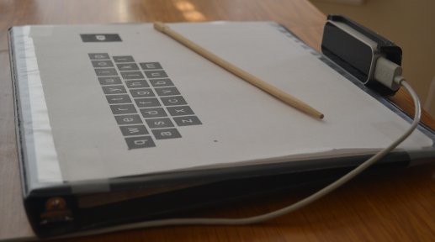
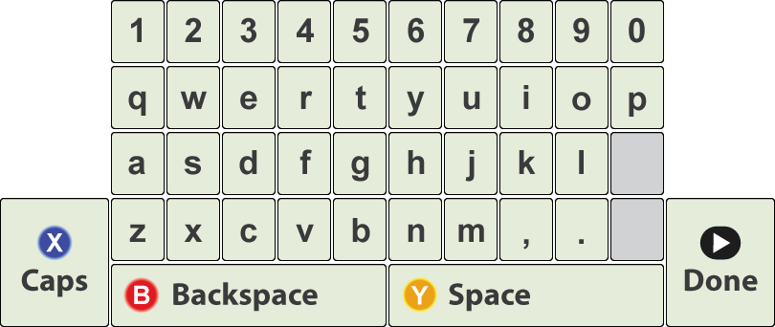
Interaction Styles
Word Separation
Touch Screen
Leap Surface
Leap Static-air
Leap Predictive-air
Leap Bimodal
Leap Pinch-air[1]
Xbox Controller?
Word Separation can be defined as the process used to delimit between words when typing (e.g., Space Bar, Touch)
Future Work Implications!

Slide 14
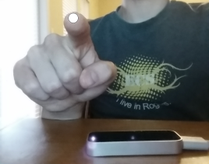
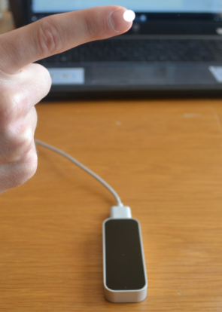
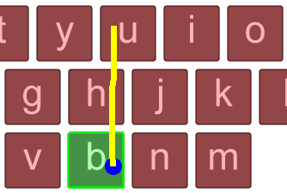
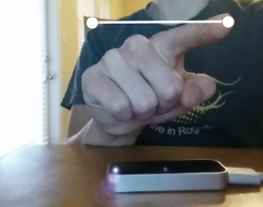
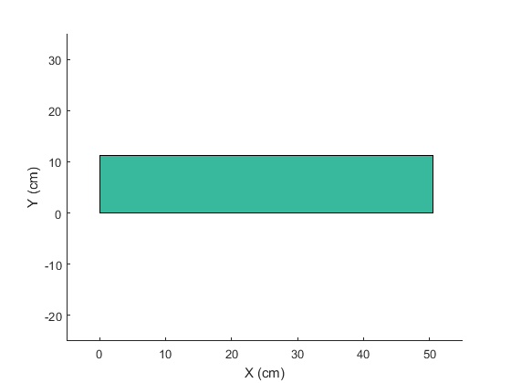
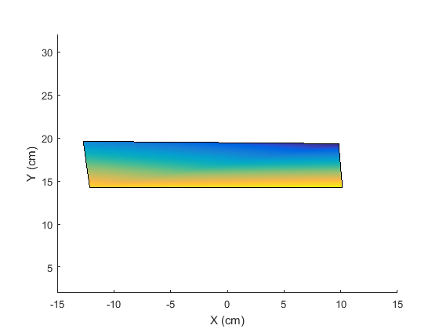
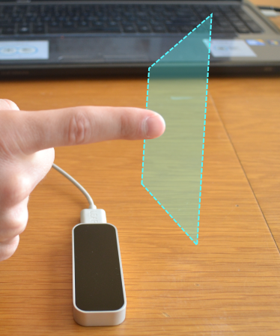
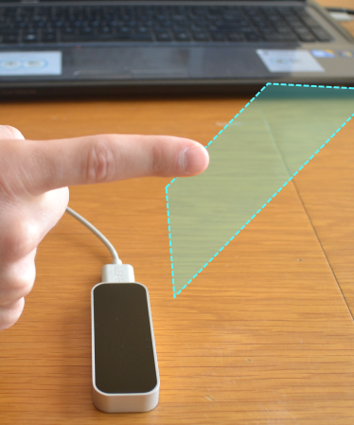
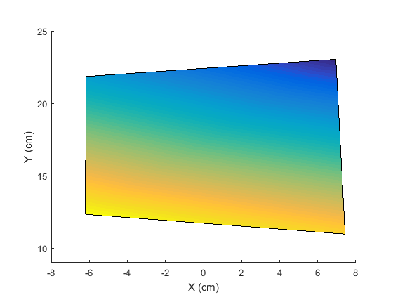
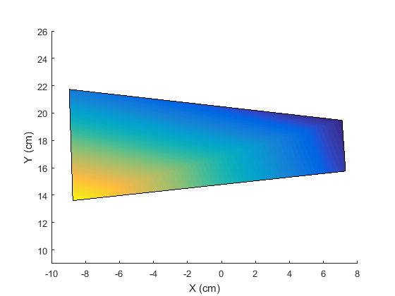
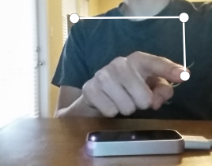
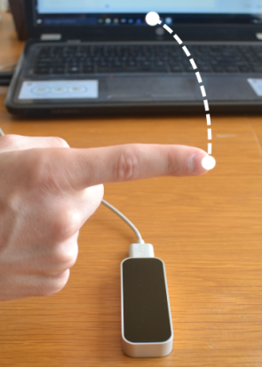
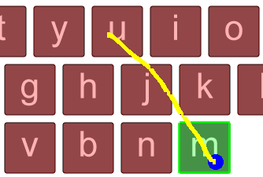
Calibration
Personal Space[22][23]
Straight vs. Angled Interaction Plane
Calibration vs. Position of Leap Motion Controller
Average Sizes of Interaction Planes
Expected Path
Actual Path

Slide 15
Experiment Design

Slide 16
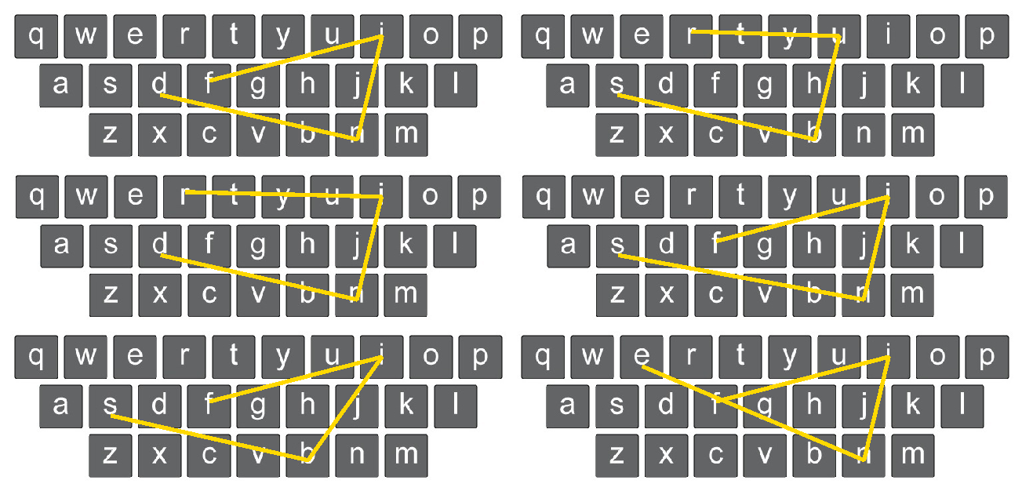
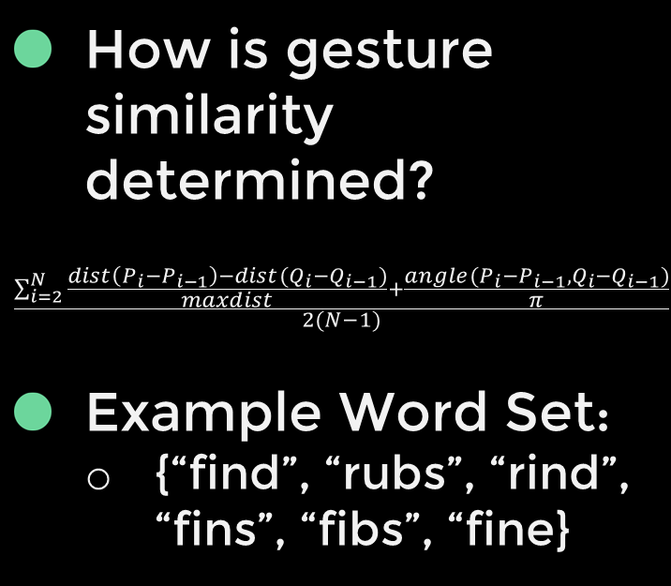
Experiment Design
Participants
Experimental Design
Task
Custom Dictionaries
Procedure
Dependent Measures
18 Participants[34]
13 Male, 5 Female
Aged 18 – 24
Right-handed
Word-gesture Experience
10 with
8 without
Within-subjects[35][36]
Replicated Latin Squares[35][37]
Task Profile for Each Keyboard
15 trials each
Selected at random from predefined, static dictionaries
90 unique words total
Trials
Words of 3-6 characters in length
Presented in random order
One at a time (no phrases[38])
Required to be correct
What is a Dictionary?
Compendium of preselected unique words
Algorithmically chosen for their gesture-shape similarity
How is gesture similarity determined?
$$\frac{\sum_{i=2}^{N}{\frac{dist\left(P_{i}−P_{i−1}\right)−dist(Q_{i}−Q_{i−1})}{maxdist}+\frac{angle(P_{i}−P_{i−1}, Q_{i}−Q_{i−1})}{π}}}{2(N−1)}$$
Example Word Set:
{“find”, “rubs”, “rind”, “fins”, “fibs”, “fine}
Text-entry Rate[39][40]
Error Rates[1][41][42]
Correctness[43]
Distance Measures
Time-based Measures
Additional Quantitative Measures
Qualitative Measures
Single Study Visit (35 – 40 min)
For Each Keyboard:
Explain
Calibrate
Practice
Task
Intermittent Survey
Exit Survey
Second Replication
First Replication
Third Replication
Participants
Conditions
7
8
9
10
11
12
F A B C D E
A B C D E F
B C D E F A
C D E F A B
D E F A B C
E F A B C D
1
2
3
4
5
6
13
14
15
16
17
18
A B C D E F
B C D E F A
C D E F A B
D E F A B C
E F A B C D
F A B C D E
E F A B C D
F A B C D E
A B C D E F
B C D E F A
C D E F A B
D E F A B C

Slide 17
Results

Slide 18
Modified Measures
Shortest Transcription
Example:
Backspace Transcription
Example:
Presented Text:
Transcribed Text:
Modified Presented:
Input
Stream:
Presented Text:
Input
Stream:
Transcribed Text:
fire
fuire
ired
ired
fuired
fuire
fire
fuired
ired
f
ire
fuired

Slide 19
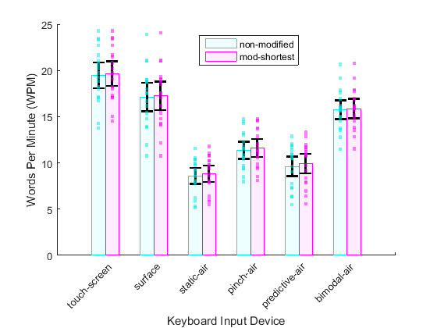
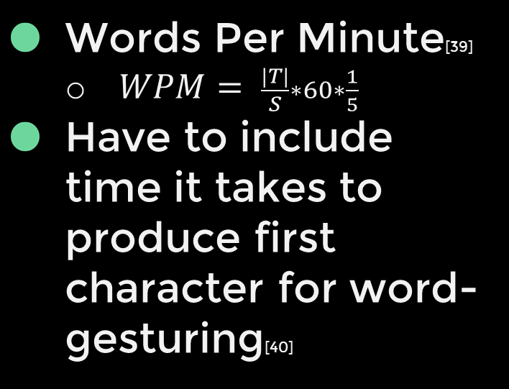
Text-entry Rate
Text-entry Rate
Pinching Consistent with Vulture[1]
11.3 vs 11.8 WMP
58% vs 59% of touch
Pinch vs Bimodal
11.3 vs 15.8 WPM
Surface vs Bimodal
88% vs 81% of touch
Errors Corrected throughout
Words Per Minute[39]
$WPM= \frac{|T|}{S}∗60∗\frac{1}{5}$
Have to include time it takes to produce first character for word-gesturing[40]
Notes:
Mention Bimodal 15.8 WPM

Slide 20
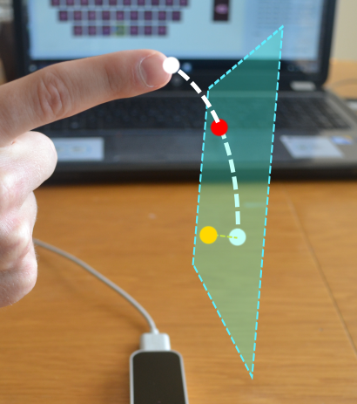
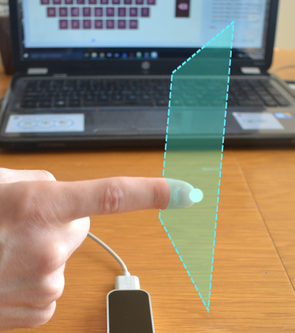




Error Rates
Minimum Word Distance[1]
Minimum String Distance[41][42]
Keystrokes Per Character[42]
Total Error Rate[42]
Greatest drops observed for:
Surface
Static-air
Predictive-air
What is causing these increased errors?

Slide 21







Correctness
Touch Screen
Leap Surface
Fréchet Distance[43]
Trends Broken
Why?
Gesture Velocity
Difference in Tracking
The Fréchet Distance for two curves P and Q is the minimum length leash needed to walk a dog when the person walks along P and the dog walks along Q
Leap Static-air
Leap Predictive-air
Leap Bimodal-air
Leap Pinch-air

Slide 22



Distance Measures
Word-gesture Distance
Velocity
Word-gesture
Hand

Slide 23




Time-based Measures
Word-gesture Duration
Reaction Time
Errors
Simulate Touch
First Correct Letter

Slide 24


Additional Quantitative Measures
Number of Touches Simulated
Number of Practice Words
No significant differences
Two classes of participants:
Same practice for each keyboard
Less practice as time goes on

Slide 25




Qualitative Measures
Likert Scale
Level of Discomfort
Level of Fatigue
Level of Difficulty
Preference Ranking
Word-gesture Experience
What does this mean for word-gesturing?
Intuitive
Beginners are Experts
?
NOT A
FACTOR!

Slide 26
Discussion

Slide 27
Analysis
Findings
Limitations
Forced Correction
Character Production Mid-gesture
Decoupling[1][24]
3D Complexity
Explicit Delimiting[1]
“Skimming” Issue
Tracking Issues
Latency
Line of Sight
Bad Calibrations
Pseudo WGK works when words are known
Pinching is consistent
Can be extrapolated to traditional implementations
3D Interactions too hard with decoupling
Leap Surface performed well
Bimodal closes the gap

Slide 28
Future Work

Slide 29







Recommendations
Word-recognition
Task Redesign
The “Skimming” Issue
Improved Tracking
Alternative Interaction Plane[22][23]
Augmented Reality
New Design
Less Conditions (Bimodal Focus)
More Trials, Repeated Sessions, & Training on Single Phrases
Phrase Sets
Notes:
Expected increases 75% and 238% for 38.9 words per minute with bimodal

Slide 30





Expansions
Multi-functional Space
Image Processing
Gaming Console Keyboards
Accessibility[7][8]

Slide 31
Conclusion

Slide 32
Significance
3rd-Dimension is Complex
Improvements with augmented reality
Bimodal
81% vs 59% of touch
Similar to touch
Lessens complexity
The future of mid-air word-gesture keyboards

Slide 33
Acknowledgements

Slide 34
Acknowledgements
Advisory Committee:
Dr. Poor
Dr. Poucher
Dr. Garner
Alvin and Darren
Ashley and the rest of the HCI personnel
All the students who participated in experiments
Heather & Family
Baylor University, the Graduate School, & the Department of Computer Science

Slide 35
References

Slide 36
References
[1] Markussen, A., M. R. Jakobsen, and K. Hornbæk (2014). Vulture: A mid-air word-gesture keyboard. In Proceedings of the SIGCHI Conference on Human Factors in Computing Systems, CHI ’14, pp. 1073–1082. ACM.
[2] Shoemaker, G., L. Findlater, J. Q. Dawson, and K. S. Booth (2009). Mid-air text input techniques for very large wall displays. In Proceedings - Graphics Interface, pp. 231–238. Canadian Information Processing Society
[3] Markussen, A., M. R. Jakobsen, and K. Hornbæk (2013). Selection-based mid-air text entry on large displays. In Human-Computer Interaction INTERACT 2013, Volume 8117(1) of Lecture Notes in Computer Science, pp. 401–418. Springer Berlin Heidelberg.
[4] Ni, T., D. Bowman, and C. North (2011). Airstroke: Bringing unistroke text entry to freehand gesture interfaces. In Proceedings of the SIGCHI Conference on human factors in computing systems, CHI ’11, pp. 2473–2476. ACM.
[5] Kristensson, P.-O., T. Nicholson, and A. Quigley (2012). Continuous recognition of one-handed and two-handed gestures using 3d full-body motion tracking sensors. In Proceedings of the 2012 ACM International Conference on Intelligent User Interfaces, IUI ’12, New York, NY, USA, pp. 89–92. ACM.
[6] Piumsomboon, T., A. Clark, M. Billinghurst, and A. Cockburn (2013). Userdefined gestures for augmented reality. In Human-Computer Interaction INTERACT 2013, Volume 8118(2) of Lecture Notes in Computer Science, pp. 282–299. Springer Berlin Heidelberg
[7] Taveira, A. D. and S. D. Choi (2009). Review study of computer input devices and older users. International Journal of Human-Computer Interaction 25 (5), 455–474
[8] Yu, W., R. Kato, F. Fabio, H. Yokoi, and Y. Kakazu (2003). An emg keyboard for forearm amputees. Applied Bionics and Biomechanics 1 (1), 33–43.
[9] Yoo, J., S. Lee, and C. Ahn (2012). Air hook: Data preloading user interface. In ICT Convergence (ICTC), 2012 International Conference, pp. 163–167. IEEE.
[10] Wachs, J. P., M. K¨olsch, H. Stern, and Y. Edan (2011, February). Vision-based hand-gesture applications. Commun. ACM 54 (2), 60–71.
[11] Triesch, J. and C. Von Der Malsburg (1998). Robotic gesture recognition by cue combination. In Informatik ’98, pp. 223–232. Springer Berlin Heidelberg.
[12] Von Hardenberg, C. and F. B´erard (2001). Bare-hand human-computer interaction. In Proceedings of the 2001 Workshop on Perceptive User Interfaces, PUI ’01, New York, NY, USA, pp. 1–8. ACM.
[13] Motion, Leap, I. (2012). Leap motion controller. https://www.leapmotion.com/[lastaccessed:2015-10-10].
[14] Weichert, F., D. Bachmann, B. Rudak, and D. Fisseler (2013). Analysis of the accuracy and robustness of the leap motion controller. Sensors (Basel, Switzerland) 13 (5), 6380–6393.
[15] Guna, J., G. Jakus, M. Pogaˇcnik, S. Tomaˇziˇc, and J. Sodnik (2014). An analysis of the precision and reliability of the leap motion sensor and its suitability for static and dynamic tracking. Sensors (Basel, Switzerland) 14 (2), 3702–3720.
[16] Sharp Toby, Cem Keskin, Duncan Robertson, Jonathan Taylor, Jamie Shotton, David Kim, Christoph Rhemann, Ido Leichter, Alon Vinnikov, Yichen Wei, Daniel Freedman, Pushmeet Kohli, Eyal Krupka, Andrew Fitzgibbon, and Shahram Izadi, Accurate, Robust, and Flexible Real-time Hand Tracking, CHI, April 2015.
[17] Banerjee, A., J. Burstyn, A. Girouard, and R. Vertegaal (2012). Multipoint: Comparing laser and manual pointing as remote input in large display interactions. In International Journal of Human - Computer Studies, Volume 70(10) of CHI ’11, pp. 690–702. Elsevier Ltd.
[18] Cockburn, A., P. Quinn, C. Gutwin, G. Ramos, and J. Looser (2011). Air pointing: Design and evaluation of spatial target acquisition with and without visual feedback. In International Journal of Human-Computer Studies, Volume 69(6), pp. 401–414. Elsevier Ltd.
[19] Jota, R., M. A. Nacenta, J. A. Jorge, S. Carpendale, and S. Greenberg (2010). A comparison of ray pointing techniques for very large displays. In Proceedings - Graphics Interface, pp. 269–276. Canadian Information Processing Society.
[20] Shoemaker, G., A. Tang, and K. S. Booth (2007). Shadow reaching: A new perspective on interaction for large displays. In Proceedings of the 20th Annual ACM Symposium on User Interface Software and Technology, UIST ’07, pp. 53–56. ACM.
[21] Vogel, D. and R. Balakrishnan (2005). Distant freehand pointing and clicking on very large, high resolution displays. In Proceedings of the 18th Annual ACM Symposium on User Interface Software and Technology, UIST ’05, pp. 33–42. ACM.
[22] Hari Haran, A. J. (2014). Giving the Users a Hand: Towards Touchless Hand Gestures for the Desktop. Masters thesis, Department of Computer Science, Baylor University, Waco, TX.
[23] Guinness, D. (2015). Models for Rested Touchless Gestural Interaction. Masters thesis, Department of Computer Science, Baylor University, Waco, TX
[24] Proctor, W. R. and L. K.-P. Vu (2006). Stimulus-Response Compatibility Principles: Data, Theory, and Application. Boca Raton, FL, USA: Taylor & Francis Group.
[25] Hincapi´e-Ramos, J. D., X. Guo, P. Moghadasian, and P. Irani (2014). Consumed endurance: A metric to quantify arm fatigue of mid-air interactions. In Proceedings of the SIGCHI Conference on Human Factors in Computing Systems, CHI ’14, New York, NY, USA, pp. 1063–1072. ACM.
[26] Jones, E., J. Alexander, A. Andreou, P. Irani, and S. Subramanian (2010). Gestext: Accelerometer-based gestural text-entry systems. In Proceedings of the SIGCHI Conference on Human Factors in Computing Systems, CHI ’10, New York, NY, USA, pp. 2173–2182. ACM.
[27] Malik, S. and J. Laszlo (2004). Visual touchpad: A two-handed gestural input device. In Proceedings of the 6th International Conference on Multimodal Interfaces, ICMI ’04, pp. 289–296. ACM.
[28] Devoe, D. (1967). Alternatives to handprinting in the manual entry of data. In IEEE Transactions on Human Factors in Electronics, Volume HFE-8(1), pp. 21–32. IEEE.
[29] Kristensson, P.-O. (2007). Discrete and Continuous Shape Writing for Text Entry and Control. Doctoral dissertation, Linkping University, Sweden.
[30] Zhai, S. and P.-O. Kristensson (2003). Shorthand writing on stylus keyboard. In Proceedings of the SIGCHI Conference on Human Factors in Computing Systems, CHI ’03, New York, NY, USA, pp. 97–104. ACM.
[31] Zhai, S. and P.-O. Kristensson (2004). Shark2: A large vocabulary shorthand writing system for pen-based computers. In Proceedings of the 17th Annual ACM Symposium on User Interface Software and Technology, UIST ’04, pp. 43–52. ACM.
[32] Zhai, S. and P. O. Kristensson (2012). The word-gesture keyboard: Reimagining keyboard interaction. Communications of the ACM 55 (9), 91–101.
[33] Zhai, S., P.-O. Kristensson, P. Gong, M. Greiner, S. A. Peng, L. M. Liu, and A. Dunnigan (2009). Shapewriter on the iphone: From the laboratory to the real world. In CHI ’09 Extended Abstracts on Human Factors in Computing Systems, CHI EA ’09, pp. 2667–2670. ACM.
[34] Dattalo, P. (2008). Determining Sample Size: Balancing Power, Precision, and Practicality. Oxford University Press.
[35] Salkind, N. J. (2010). Encyclopedia of Research Design. Thousand Oaks, California: SAGE Publications, Inc.
[36] Kim, J. (2010). Within-subjects design. See [35].
[37] Zhang, H. (2010). Latin square design. See [35].
[38] MacKenzie, I. S. and R. W. Soukoreff (2003). Phrase sets for evaluating text entry techniques. In CHI ’03 Extended Abstracts on Human Factors in Computing Systems, CHI EA ’03, New York, NY, USA, pp. 754–755. ACM.
[39] Bi, X., C. Chelba, T. Ouyang, K. Partridge, and S. Zhai (2012). Bimanual gesture keyboard. In Proceedings of the 25th Annual ACM Symposium on User Interface Software and Technology, UIST ’12, pp. 137–146. ACM.
[40] MacKenzie, I. S. and K. Tanaka-Ishii (2007). Text Entry Systems: Mobility, Accessibility, Universality. San Francisco, CA, USA: Morgan Kaufmann Publishers Inc
[41] Soukoreff, R. W. and I. S. MacKenzie (2003). Metrics for text entry research: An evaluation of msd and kspc, and a new unified error metric. In Proceedings of the SIGCHI Conference on Human Factors in Computing Systems, CHI ’03, New York, NY, USA, pp. 113–120. ACM.
[42] MacKenzie, I. S. and R. W. Soukoreff (2002). A character-level error analysis technique for evaluating text entry methods. In Proceedings of the Second Nordic Conference on Human-computer Interaction, NordiCHI ’02, New York, NY, USA, pp. 243–246. ACM.
[43] Har-Peled, S. and B. Raichel (2014, January). The Fréchet distance revisited and extended. ACM Trans. Algorithms 10 (1), 3:1–3:22.

Slide 37
Questions
Alternatives Using the Leap Motion to Extend Mid-air Word-gesture Keyboards

